Slide 1


Ioan and Tim

Slide 2

2 grids are used: 1 string and 1 integer
The string grid is used for display
The integer grid is hidden and used for mine placement, and hints
Mines have a value of -1 on the integer grid
The String grid contains “X “ everywhere when initialized
An “F “ is placed in a flagged square

Slide 3

Easy
  Grid Size: 10x10
  Initial Points: 1000
  # and % of bombs: 10 bombs (10%)
Medium
  Grid Size: 15x15
  Initial Points: 2000
  # and % of bombs: 45 bombs (20%)
Hard
  Grid Size: 20x20
  Initial Points: 3000
  # and % of bombs: 120 bombs (30%)

Slide 4
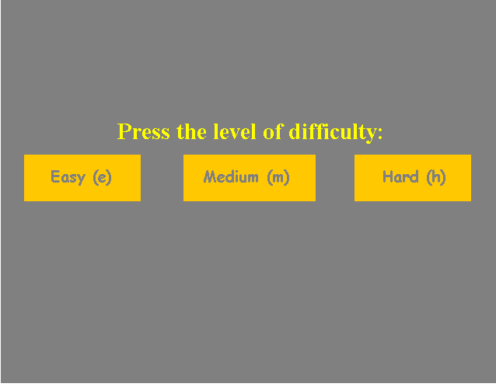

Slide 5

Section 0: Menu in the main method and public variables
Section 1: Game Setup and Screen
Section 2: Game play and interface
Section 3: File Handling: Writing to and reading from files
Section 4: Solution for game
Section 5: Testing of the Program

Slide 6

Main Menu
High Score
Instructions
Play
Quit
New Game
Load
Easy
Medium
Hard

Slide 7

The main menu is displayed and using char key, the user can go to either Play, High Score, Instructions or Quit
In a huge do loop, we keep getting input until one of the 4 options is selected
Since the getting char key is not in the if statement, the four menu options will share the same char key in which each menu options act as the main menu

Slide 8
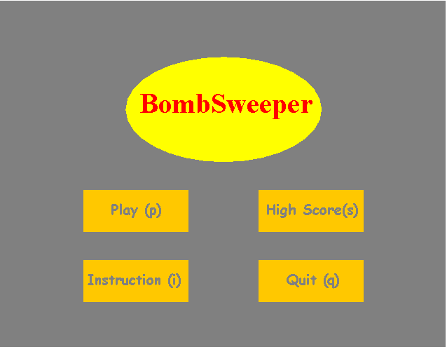
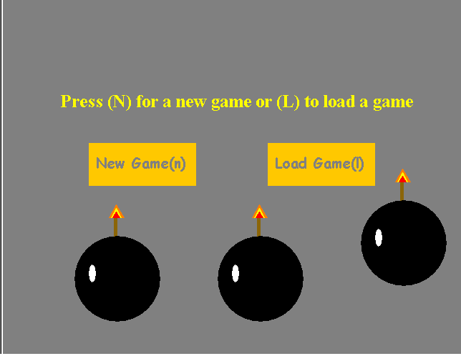


Slide 9

We are using 4 methods for this section : Play, RecursiveEmpty, CountMine and InitializeMine
InitializeMine: randomly generate coordinates that are in bound of the grid and places “-1” in that square on the integer grid
CountMine: adds hints by finding mines (-1) and adding 1 to each adjacent square that exists and is not a mine (-1)

Slide 10

RecursiveEmpty: Recursively opens empty boxes.
First checks if coordinates given exist. If so, it checks if the box is a 0 and not flagged (X) or if the box is greater then 0 (contains a hint) and not flagged (X).
In the first case, it opens the box and recursively calls itself for all the adjacent boxes. In the second case, it simply opens the box containing a hint without further recursion.

Slide 11
Play method: Gets char key input from user that allow the cursor to move up/down/left/right, open or flag boxes.
The loop ends when the user wins or loses
Win: counter who determines the number of (non mine) boxes left to be open equals 0
Lose: Open a mine

Slide 12
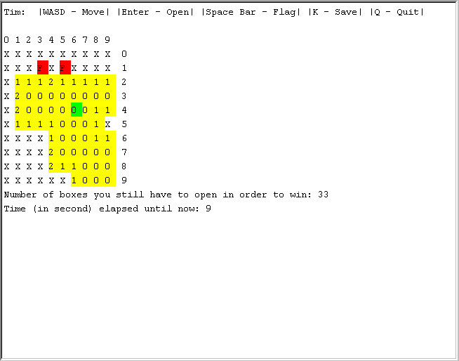

Slide 13

Contains 3 methods: Display, InitializeDisplayGrid, Instruction
Display: This method is refreshed every time the user enters a char key. It displays the instructions, the displayable grid, the green cursor and the updated time.
InitializeDisplayGrid: This method sets all the values in the string based grid to an “X “ and displays it

Slide 14

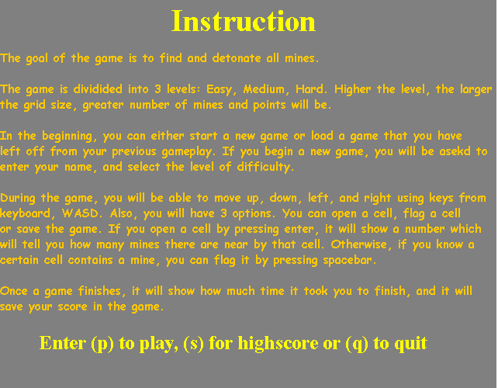
Instruction: This method simply shows the instructions by drawing strings

Slide 15

Contains 2 methods: LoadGame and SaveGame
SaveGame: This method writes to a file, line by line the time in seconds, the name, the level, the variable winncount. Then it writes line by line each value from the displayable grid and finally each value from the non-displayable grid.

Slide 16

LoadGame: This method reads line by line the file save file with the name user has assigned when a game has been saved and sets each variable in the program accordingly. Every time a variable is needed as an integer, we use parse int.

Slide 17
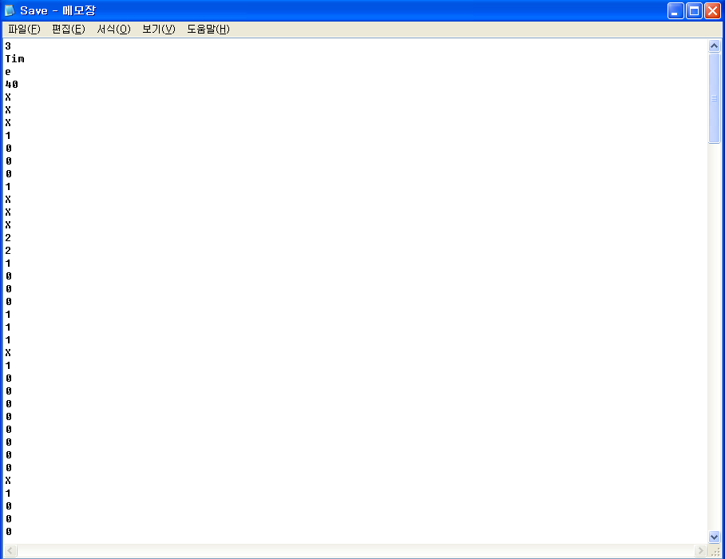

Slide 18

DisplayIntGrid is the method used
Whenever a user loses, we show the integer based grid which contains the answers. Since displaying -1 doesn’t look good, we display every bomb using a “B”

Slide 19
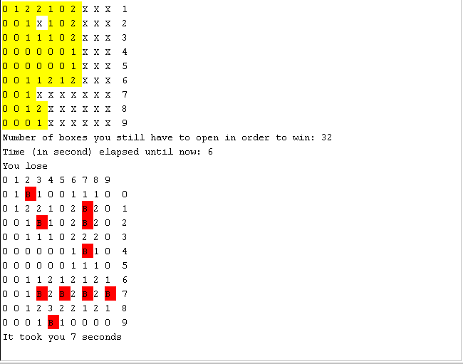

Slide 20

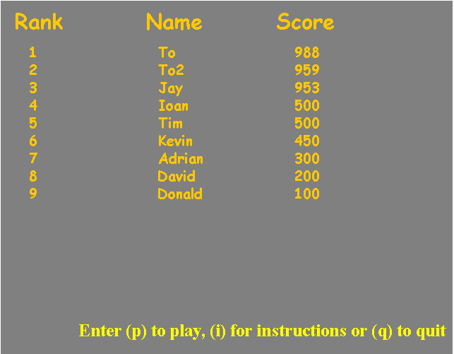
The score is calculated using this formula:
Score = initial level points - time(in seconds)
Initial level points:
Easy: 1000
Medium: 2000
Hard: 3000

Slide 21

5 Methods used: HS, Hslength, InsertionSort, HSStore and HSDisplay
InsertionSort: This method sorts in descending order based on the score two arrays: one containing the scores and the others the names
Hslength: This method reads the high score file and returns its length (number of names)
HS: this is a helper method that loads the high scores and names into 2 separate arrays

Slide 22

HSStore: This method is used to store a new high score
HSDisplay: This method reads from the file and displays the high scores

Slide 23

Every method has been tested separately
Every section from the menu has been tested
The game has been tested in all the 3 levels
Several times, games have been saved and reloaded
The timer has been observed and debugged
Both expected and unexpected inputs have been tested to ensure the game is crash-proof

Slide 24
Input | Output | Expected Output
In the main menu, the user presses given keys (Ex. “P” for Play) | Either invokes a method or display a different console | Display different menu options
The user presses unassigned keys | No action until the user presses the right key | No action until the user presses the right key
In the play section, the user presses n | Displays new console and ask for name and difficulty of level | Display pictures and take user inputs
The user selects level | Output the grid based on the types of level | Depending on the levels, output different grid.
In the play section, the user presses l | Loads up the previously saved game if exists. If not, start a new game. | Invokes the LoadGame method, and loads the saved game.
Any other inputs | Display invalid input and continue outputting until user presses the right key. | Message saying “invalid input” is displayed and should take new input
In game, the user presses w | Move up a square | Move up a square
Presses S | Move down a square | Move down a square
Presses A | Move left a square | Move left a square

Slide 25
Presses D | Move right a square | Move right a square
Presses Enter | Opens the square and output a number from 1-8 depending on how many bombs there are nearby | Opens the square: changes the “X” by outputting a number from 1-8 depending on the number of bombs nearby.
Presses Space Bar | Flags a square and output “F” | Flags a square and output “F”
Presses K | Invokes the method SaveGame, and the program writes the grid to the text file line by line. | Calls the saving game method and writes both grids line by line.
Presses Q | Closes the program | Closes the program
The User Wins (Any Levels) | Displays the user has won and the amount of time taken to finish the game | Output amount of time spent and a message
The User Loses (Any Levels) | Displays the user has lost and the amount of time taken to finish the game, and hidden grid | Output amount of time spent, a message, and the hidden grid.

Slide 26



